Slide 1
The Fundamental of Mobile Robot
Machine Perception and Interaction Group (MPIG)
http://www.mpig.com.cn
szl@mpig.com.cn

Slide 2
Send an email with specified subject ‘Robot stuff’ to
assignments.shmtu@gmail.com
An automatic reply will come.
All you need would be included!

Slide 3

assignments.shmtu@gmail.com

Slide 4


All the codes accompanying this course are open-sourced at Github.
The project homepage:
https://github.com/sunzuolei/robotcourse
The git repository:
https://github.com/sunzuolei/robotcourse.git
Learn more about git:
http://en.wikipedia.org/wiki/Git_(software)
The best GUI-based git client on Windows:
https://code.google.com/p/tortoisegit/

Slide 5
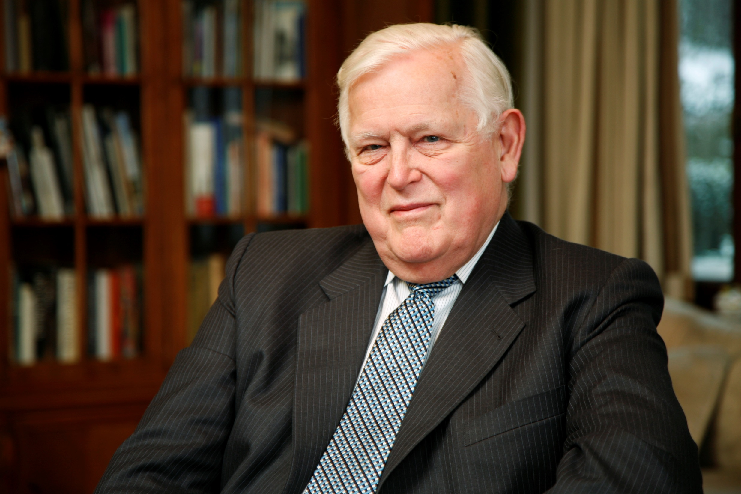
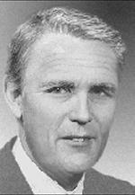
Kalman
Filter
Rudolf (Rudy) Emil Kálmán
May 19, 1930–
A Hungarian-American electrical engineer, mathematical system theorist
http://en.wikipedia.org/wiki/Rudolf_E._K%C3%A1lm%C3%A1n

Slide 6
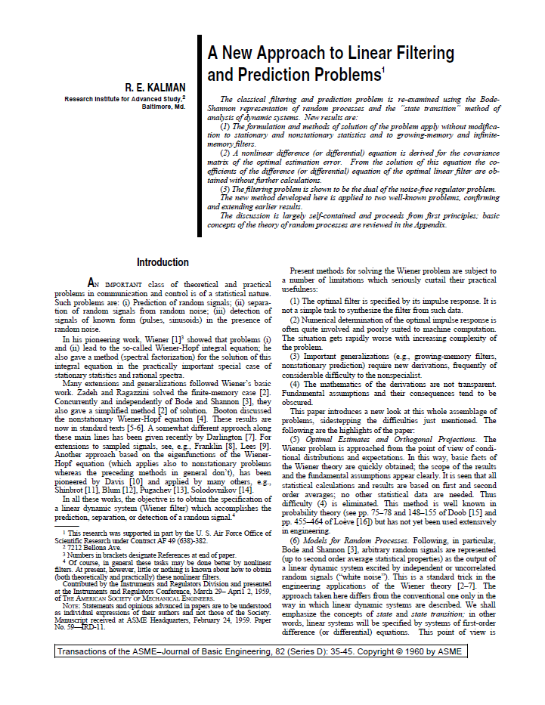
@article{
Author = {Kalman, Rudolph Emil},
Title = {A New Approach to Linear Filtering and Prediction Problems},
Journal = {Transactions of the ASME--Journal of Basic Engineering},
Volume = {82},
Number = {Series D},
Pages = {35--45},
Year = {1960} }

Slide 7
Why filtering?

Slide 8
The measurements and actuations are corrupted by noise.
The state we are interested in sometimes are not directly observable
Multi-sensors are often employed to bound posterior uncertainty.

Slide 9
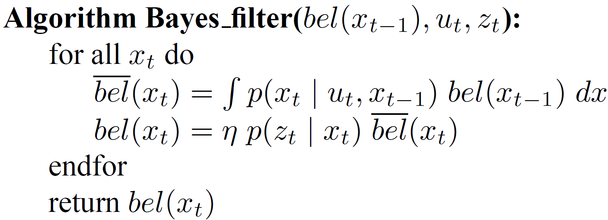
The posterior of previous time step
The posterior of current time step

Slide 10
Convolution
Prediction
Motion model
Product
Update
Observation model

Slide 11



Posterior
Updated state

Slide 12
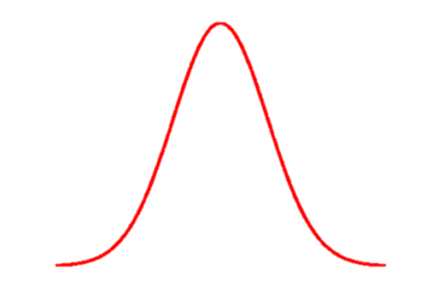
Posterior
Posterior is a probability distribution. If it is assumed as Gaussian, mean and (co)variance are the moments being of interest.
Updated state
State always refers to the mean of a distribution, that is, the first moment.

Slide 13
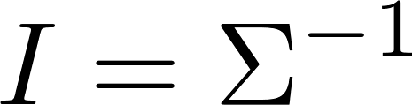
Fisher information
A measure of information commonly used in probabilistic modeling and estimation other than Shannon information (Entropy)
Fisher information is a matrix, often called information matrix, which plays a crucial role in SLAM.

Slide 14
Gravitating property (the central limit theorem)
In probability theory, the central limit theorem (CLT) states that, given certain conditions, the mean of a sufficiently large number of independent random variables, each with a well-defined mean and well-defined variance, will be approximately normally distributed.
http://en.wikipedia.org/wiki/Central_limit_theorem

Slide 15
Is Bayes filter enough?

Slide 16
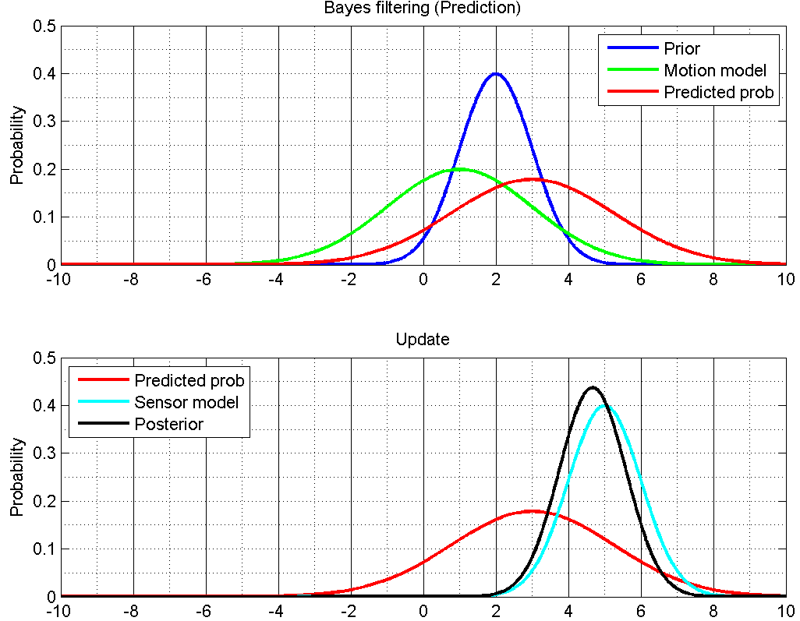
1D

Slide 17
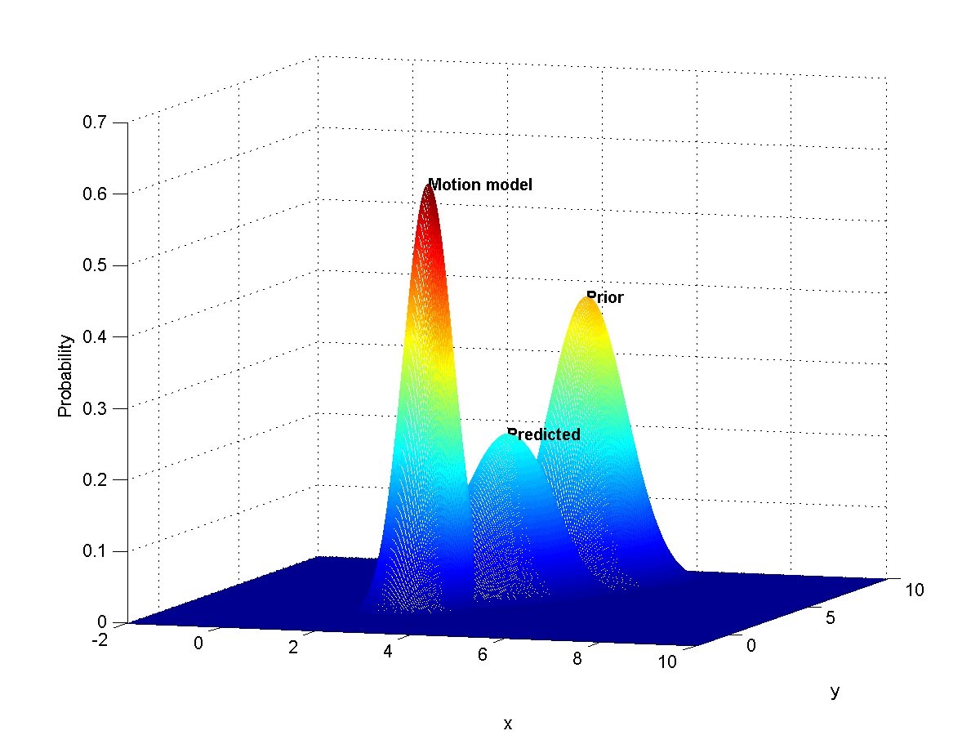
2D

Slide 18
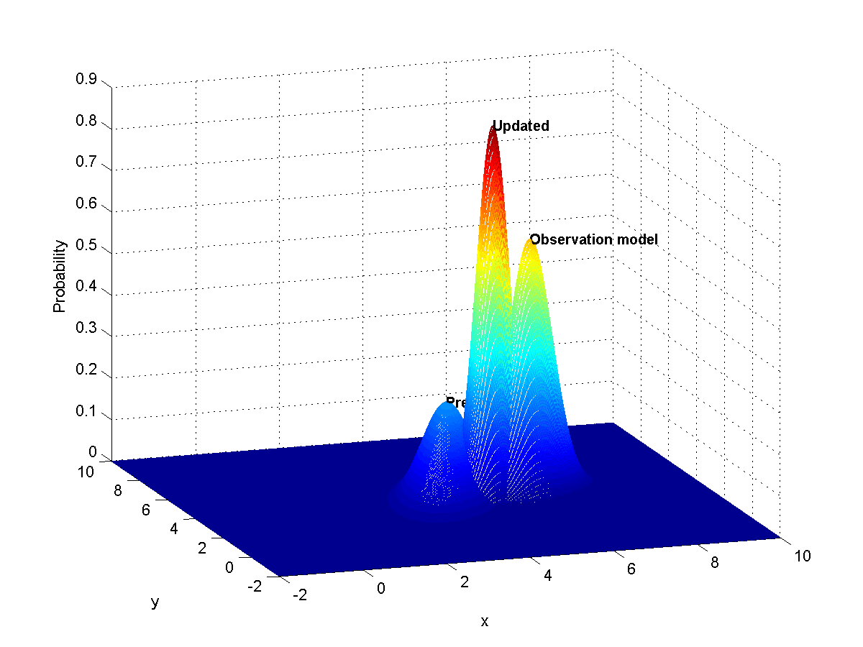
2D
Predicted

Slide 19
ND

Slide 20
It is hard to visualize the Bayes filtering procedure, when the system state vector is of more than two dimensions.
But, in theory, Bayes filtering can still preform with the Mont Carlo approach as long as we can specify the feasible convolution and product algorithms.

Slide 21
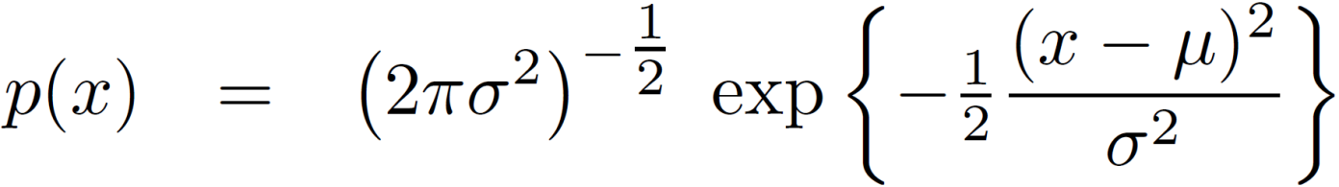
Expensive
1D
Multi-dimensional

Slide 22
We need more efficient way

Slide 23
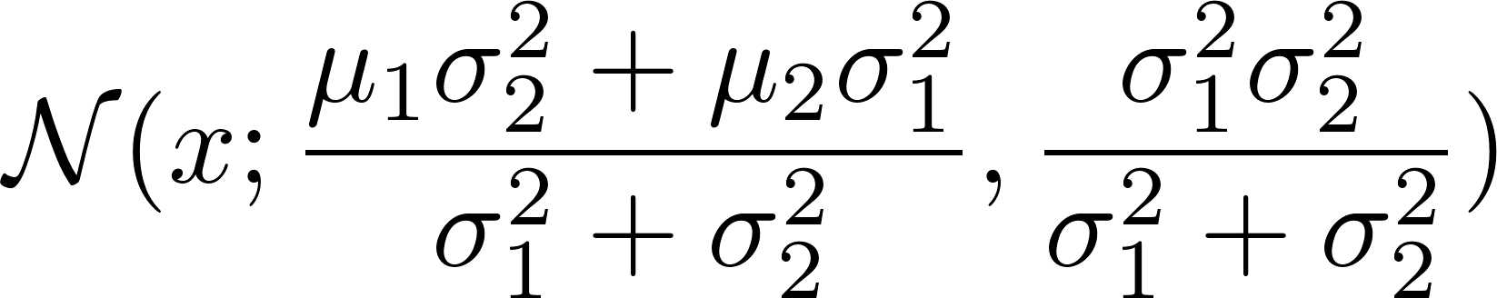
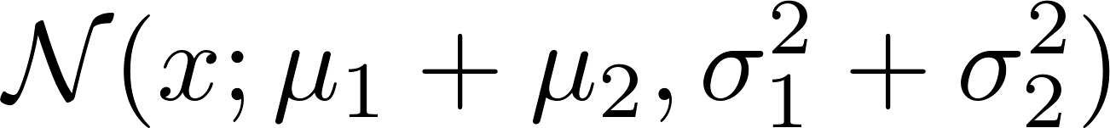
Convolution
Product
Update
Prediction
Convolution
Prediction
1D
It is actually 1D Kalman filter

Slide 24
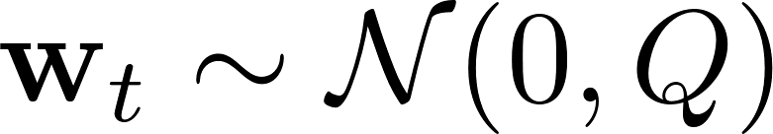
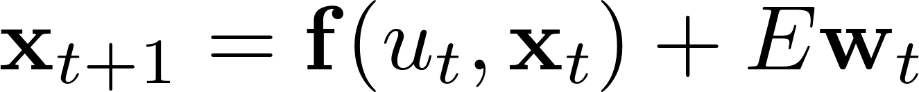


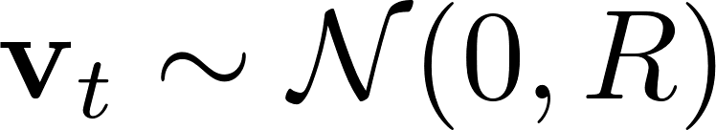
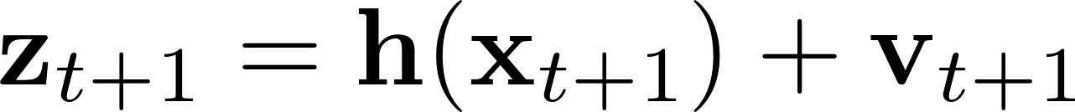
The general motion model
The general sensor model

Slide 25
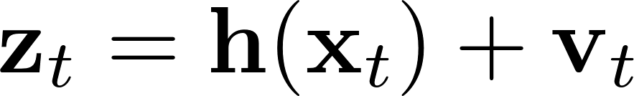
The general motion model
The general sensor model

Slide 26
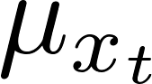
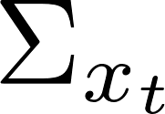
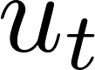
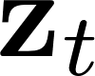
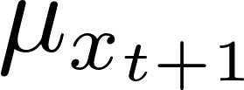
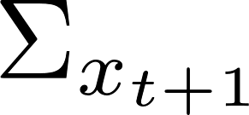
The input & output of Kalman filter
Input
Output

Slide 27
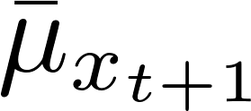
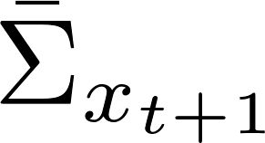
The essential operation of Kalman filter is evolving the Gaussian prior by maintaining the mean and covariance.
Prediction
/ time update / motion propagation / process update
Update
/ measurement update / correction

Slide 28
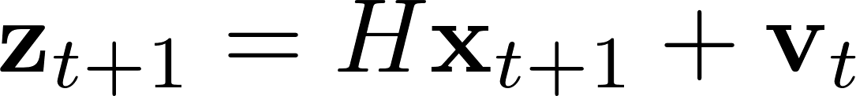
Linear models
Linear motion model
Linear sensor model

Slide 29
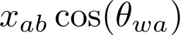
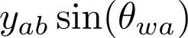
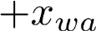
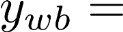
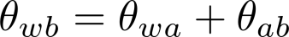
Is this linear ?

Slide 30
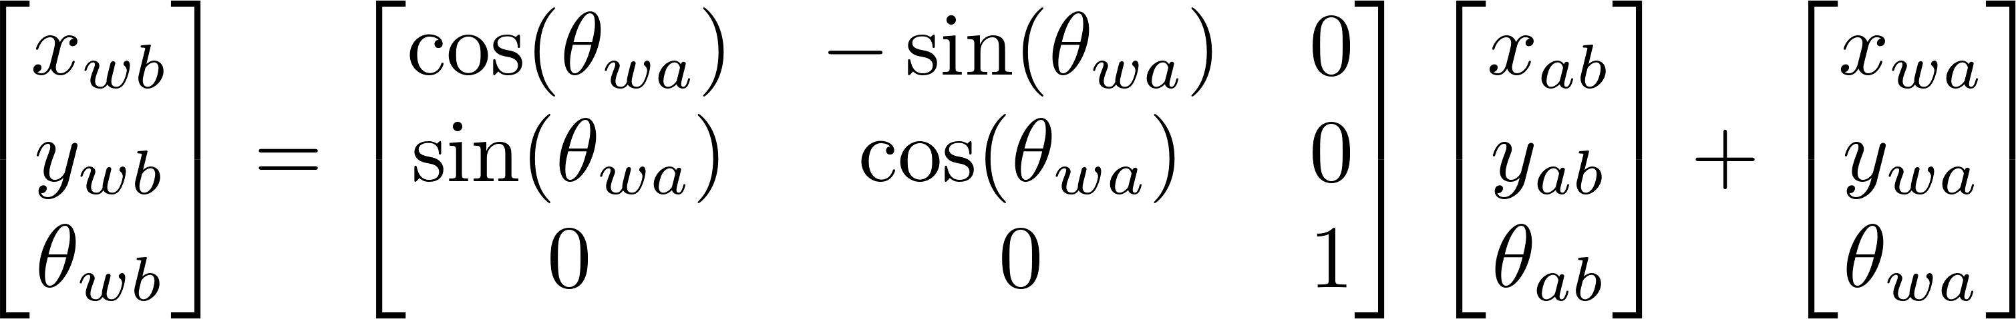
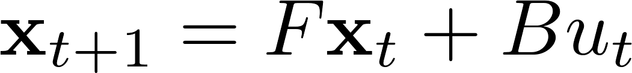

Slide 31
No, it is nonlinear, since the elements contained in the matrix are correlated with state.

Slide 32
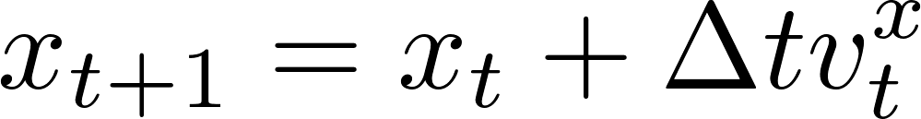
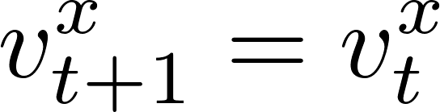
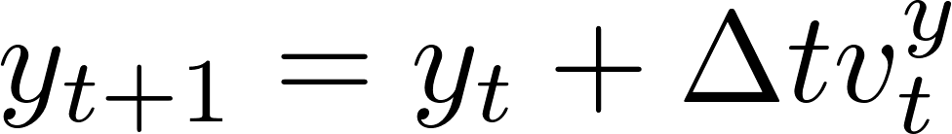
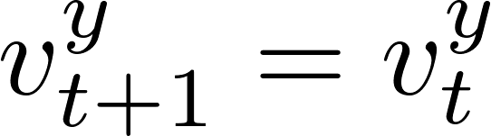
Constant velocity model
Is this linear ?

Slide 33
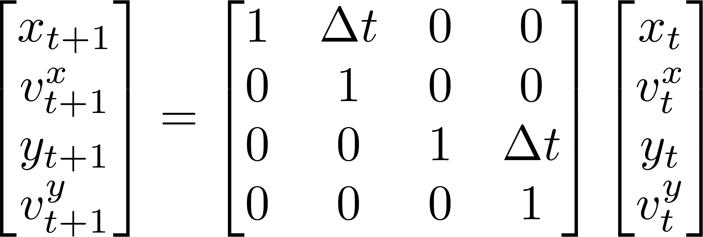
Constant velocity model
F
Yes, it is linear.

Slide 34
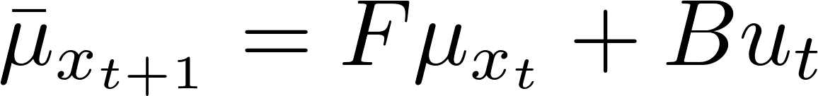
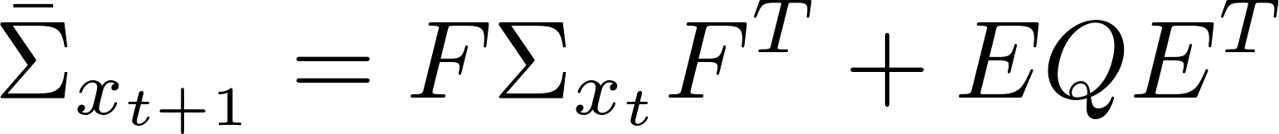
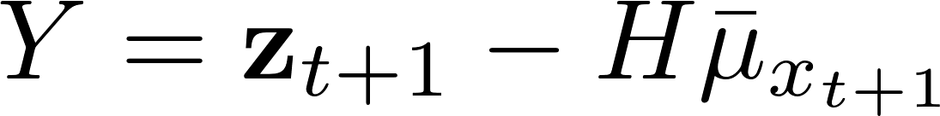
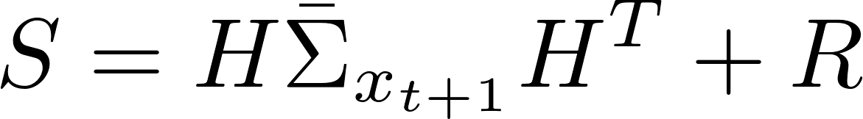
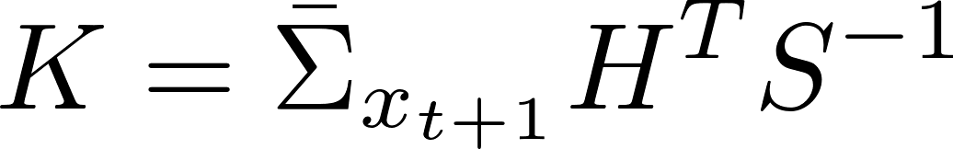
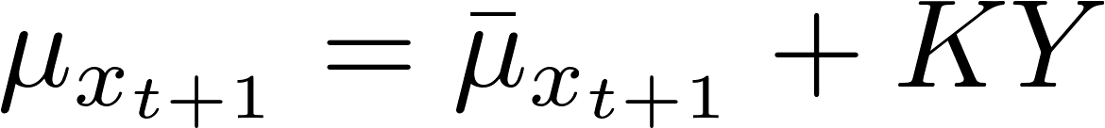
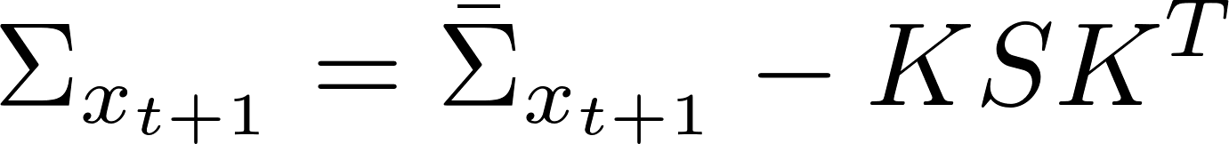
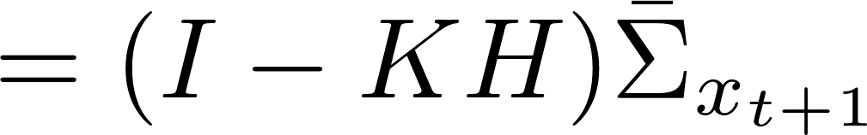
Prediction
Update
Innovation / Residual
Innovation variance
Kalman gain
Linear Kalman filter

Slide 35
Derivation of the Kalman filtering routine
http://services.eng.uts.edu.au/~sdhuang/Kalman%20Filter_Shoudong.pdf

Slide 36
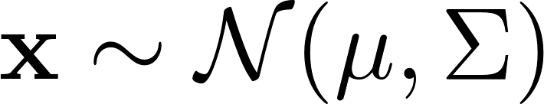
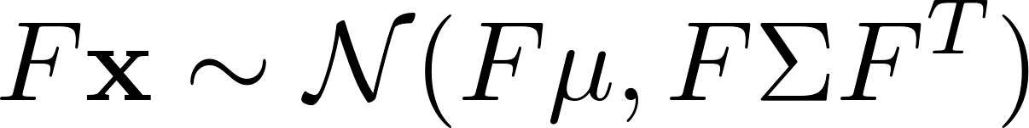
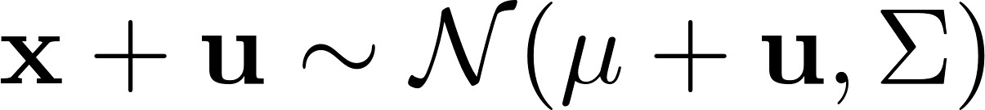
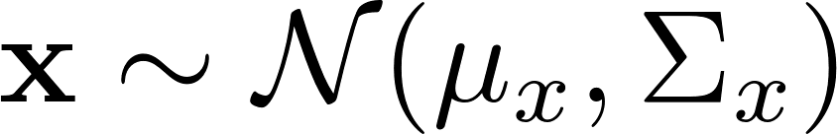

Nice properties of Gaussian distribution
ND

Slide 37



Motion model

Slide 38



Motion model

Slide 39
Motion model

Slide 40
Motion model

Slide 41
Motion model

Slide 42
Motion model

Slide 43

Motion model

Slide 44
Prediction
Update
Innovation / Residual
Innovation variance
Kalman gain
Linear Kalman filter

Slide 45
Sensor model

Slide 46


Sensor model

Slide 47
Sensor model

Slide 48
Sensor model
Is the distribution the Posterior?

Slide 49
The information about the Posterior can be divided into two pieces:
Indicates the information from involving observations
Indicates the information from prediction

Slide 50
With information matrix (Fisher information), the total information of posterior can be formulated as:

Slide 51

With information matrix (Fisher information), the total information of posterior can be formulated as:
Indicates the information from prediction

Slide 52



With information matrix (Fisher information), the total information of posterior can be formulated as:
Indicates the information from involving observations

Slide 53
With information matrix (Fisher information), the total information of posterior can be formulated as:

Slide 54
Matrix Inversion Lemma

Slide 55

Denote
Denote

Slide 56
Prediction
Update
Innovation / Residual
Innovation variance
Kalman gain
Linear Kalman filter

Slide 57
The mean of the posterior is the weighted sum of the mean values of the two Gaussian distributions. The weights are decided by the proportion of information contained in each of the Gaussian distributions.
Indicates the information from involving observations
Indicates the information from prediction

Slide 58
The mean of the posterior is the weighted sum of the mean values of the two Gaussian distributions. The weights are decided by the proportion of information contained in each of the Gaussian distributions.
Indicates the information from involving observations

Slide 59


Slide 60
Denote
Denote

Slide 61
Prediction
Update
Innovation / Residual
Innovation variance
Kalman gain
Linear Kalman filter

Slide 62

U.S. President Barack Obama presents a 2008 National Medal of Science to Rudolf Kalman of Swiss Federal Institute of Technology in Zurich during an East Room ceremony October 7, 2009 at the White House.

Slide 63
Demonstrate Linear Kalman Filter by Simulation

Slide 64
What is the definition of simulation?
http://en.wikipedia.org/wiki/Simulation
Simulation is the imitation of the operation of a real-world process or system over time.
The act of simulating something first requires that a model be developed; this model represents the key characteristics or behaviors of the selected physical or abstract system or process.
The model represents the system itself, whereas the simulation represents the operation of the system over time.

Slide 65

Is it simulation?

Slide 66




No! the real data collected based on field test is used.

Slide 67

Is it simulation?

Slide 68
Yes! the data is imitated with models.

Slide 69
In simulation, the data is generated by running the specified model in which the noise should be considered.
The Gaussian white noise is always employed to model process and sensor noise.
white noise is a random signal with a flat (constant) power spectral density. In other words, a signal that contains equal power within any frequency band with a fixed width.
In particular, if each sample has a normal distribution with zero mean, the signal is said to be Gaussian white noise.
http://en.wikipedia.org/wiki/White_noise

Slide 70




Slide 71


Understand randn in Matlab
randn generate normally distributed pseudorandom number sequence M:
How to generate a data sequence X for a Gaussian distribution?

Slide 72


Understand randn in Matlab
randn generate normally distributed pseudorandom number sequence M:
a + sqrt(b). * randn(n, 1);

Slide 73

Simulate a Gaussian white noise containing 1000 samples w:
Ensure that the noise can be reproduced exactly the same each time
Let’s implement this!

Slide 74
rng(222);
noiseA = randn(1, 5);
rng(222);
noiseB = randn(1, 5);
disp(noiseA - noiseB);
P35
0 0 0 0 0
Rng can specify the random number generator, see the help documents in Matlab for more information. In most cases, rng is called once at the very beginning.

Slide 75
meanXNoise = 0;
meanYNoise = 0;
sigmaXNoise = 0.1;
sigmaYNoise = 0.2;
numSamples = 1000;
SigmaNoise = [sigmaXNoise^2, 0;
0, sigmaYNoise^2];
meanNoise = [meanXNoise, meanYNoise];
randnSamps = randn(numSamples, 2);
P36
%% Fist option
xNoise = meanXNoise + sigmaXNoise .* randnSamps(:, 1);
yNoise = meanYNoise + sigmaYNoise .* randnSamps(:, 2);
noise1 = [xNoise, yNoise];

Slide 76
%% Second option
noise2 = repmat(meanNoise, numSamples, 1) + ...
repmat([sigmaXNoise, sigmaYNoise], numSamples, 1) .* randnSamps;
%% Third option
noise3 = repmat(meanNoise, numSamples, 1) + ...
randnSamps * chol(SigmaNoise);
%% Fourth option
noise4 = repmat(meanNoise', 1, numSamples) + ...
chol(SigmaNoise) * randnSamps';
noise4 = noise4';
%% Fifth option
noise5 = repmat(meanNoise, numSamples, 1) + ...
randnSamps * sqrt(SigmaNoise);
P36

Slide 77

P36

Slide 78



P36
68–95–99.7 Rule

Slide 79
Noise
White
Gaussian
Additive
Uncorrelated
http://en.wikipedia.org/wiki/Additive_white_Gaussian_noise
http://en.wikipedia.org/wiki/White_noise

Slide 80
Rand
Uniformly distributed pseudorandom numbers
Generate values from the uniform distribution on the interval [a,b]:
Randn
Normally distributed pseudorandom numbers
Generate values from a normal distribution with mean 1 and standard deviation 2:
r = a + (b-a).*rand(100,1);
r = 1 + 2.*randn(100,1);

Slide 81

Rand
Randn
P36rand
P36

Slide 82

Constant velocity model
Suppose the robot moves in a 2D world with the constant velocity, what is the state of our interest? What is the motion / process model?

Slide 83
Constant velocity model
We model the dynamic in x and y direction respectively.

Slide 84
Constant velocity model
What are the matrix F, B compare to the standard linear motion model?

Slide 85
Constant velocity model
F
B

Slide 86
Constant velocity model
Can the ground truth be simulated based on above ‘motion model’ ? Why?

Slide 87

Constant velocity model
No! The process noise is required as the motor that drives robot is not perfect.

Slide 88
Constant velocity model
What is the process noise in the CV model?

Slide 89


Constant velocity model

Slide 90

What is the process noise transition matrix?
Constant velocity model

Slide 91

Constant velocity model
F
E
Let’s simulate robot’s motion truth!

Slide 92


P37

Slide 93
dt = 0.1;
step = 100;
x = [0, 0.5, 0, 0.4]';
sigmaVx = 0.2;
sigmaVy = 0.1;
xAll = zeros(length(x), step);
xAll(:,1) = x;
%%
F = [1, dt, 0, 0;
0, 1, 0, 0;
0, 0, 1, dt;
0, 0, 0, 1];
E = [dt^2/2, 0;
dt, 0;
0, dt^2/2;
0, dt];
Q = [sigmaVx^2, 0;
0, sigmaVx^2 ];
w = chol(Q) * randn(size(Q, 1), step);
for i = 2 : step
x = F * x + E * w(:, i);
xAll(:, i) = x;
end
P37

Slide 94


Measurement
model
It is not hard to measure position with the low-cost sensor, like GPS receiver.
On the contrary, the velocity is not directly observable.

Slide 95

Measurement
model
What is the relationship between measurements and robot state?

Slide 96


Measurement
model

Slide 97

Measurement
model
Imperfect sensor

Slide 98


Measurement
model

Slide 99

H
Measurement
model
Let’s simulate the observation!

Slide 100

P38

Slide 101
H = [1, 0, 0, 0;
0, 0, 1, 0];
R = [sigmaZx^2, 0;
0, sigmaZy^2 ];
v = sqrt(R) * randn(size(R, 1), step);
%%
xAll = zeros(length(x), step);
xAll(:,1) = x;
zAll = zeros(size(R, 1), step);
zAll(:,1) = H * x + v(:, 1);
%%
for i = 2 : step
x = F * x + E * w(:, i);
z = H * x + v(:, i);
xAll(:, i) = x;
zAll(:, i) = z;
end
P38

Slide 102
Linear models
Linear motion model
Linear sensor model

Slide 103
Prediction
Update
Innovation / Residual
Innovation variance
Kalman gain
Linear Kalman filter

Slide 104
Everything is ready, Let’s implement CV motion-based linear Kalman filter!
P39

Slide 105
%% Linear KF prediction
if hasU
muPred = F * mu + B * u;
else
muPred = F * mu;
end
if hasE
SigmaPred = F * Sigma * F' + E * Q * E';
else
SigmaPred = F * Sigma * F' + Q;
end
P39
function [muPred, SigmaPred] = predictLKF
(mu, Sigma, F, Q, varargin);
Prediction

Slide 106
P39
if mod(argLen, 2) ~= 0 || argLen > 6
error('Wrong number of arguments.');
end
if nargin < 4
error('Not enough input arguments.');
end
if size(mu, 2) ~= 1
error('The state shoud be column vector.');
end
if size(Sigma, 1) ~= size(Sigma, 2)
error('The covariance matrix should be symmetrical.');
end
if size(Sigma, 1) ~= muLen
error('Wrong size of state or covariance matrix.');
end
Verify the dimensions

Slide 107
%% Extract the arguments
hasU = false;
hasUMat = false;
hasE = false;
for i = 1 : 2 : argLen
switch lower(strtrim(cell2mat(varargin(i))))
case 'control'
u = cell2mat(varargin(i + 1));
hasU = true;
if size(u, 2) ~= 1
error('The control shoud be column vector.');
end
case 'controlmat'
B = cell2mat(varargin(i + 1));
hasUMat = true;
case 'processnoisemat'
E = cell2mat(varargin(i + 1));
if size(Q, 1) ~= size(E, 2) || size(Q, 2) ~= size(E, 2)
error('Wrong size of noise matrix or noise covariance matrix.');
end
hasE = true;
otherwise
error(['Invalid argument: ', cell2mat(varargin(i))]);
end
end
P39

Slide 108
Time alignments
…
Initial state
Prediction
Prediction
Update
Update
Update
for i = 1 : step
if i ~= 1
[mu, Sigma] = predictLKF(mu, Sigma, F, Q, 'processNoiseMat', E);
muPred(:,i) = mu;
SigmaPred(:,:,i) = Sigma;
end
[mu, Sigma, innov(:,i), SigmaInnov(:,:,i)] =...
updateLKF(mu, Sigma, zTrue(:,i), H, R);
muPost(:,i) = mu;
SigmaPost(:,:,i) = Sigma;
end

Slide 109
Noise configuration
Two types
For filtering
For truth generation
%% Process noise for filter
sigmaVxNoise = 0.01;
sigmaVyNoise = 0.01;
Q = (1.0 * [sigmaVxNoise, 0; 0, sigmaVyNoise]).^2;
%% Measurement noise for filter
sigmaXNoise = 0.1;
sigmaYNoise = 0.1;
R = (1 * diag([sigmaXNoise, sigmaYNoise])).^2;
%% Noise for simulating truths
simQ = diag([sigmaVxNoise,sigmaVxNoise].^2);
simR = diag([sigmaXNoise, sigmaYNoise].^2);

Slide 110

P39
animation.m

Slide 111
We shall make a point of not showing the true value as in any real situation this will not be available to us to study filter performance.
It is difficult to see from this graph how the filter works because the changes in position due to velocity and acceleration changes dominate the effects of estimation uncertainty.

Slide 112
Coding KF is straightforward, but…
The successful implementation tends to be very problem-specific, relying heavily on engineering judgment to adjust and tune process, sensor and noise models.
As a rule of thumb, it takes an order of magnitude more time and effort to tune and adjust a filter to work well, over the time it takes to implement the basic algorithm.

Slide 113
Let’s demonstrate the performance

Slide 114

P40

Slide 115

Why does the updated estimation always lies between the predicted position and the observation?

Slide 116
The mean of the posterior is the weighted sum of the mean values of the two Gaussian distributions. The weights are decided by the proportion of information contained in each of the Gaussian distributions.

Slide 117
The weights associated with the observations and predictions during an update tend to constant values.
when a steady-state has been achieved, the estimate will lie between observation and prediction in constant proportion.
Steady-state

Slide 118

What is the reason for the apparent lag between predicted and updated velocities?

Slide 119
The robot is actually accelerating while the motion model assumes that the velocity is constant.
The velocity estimates are smoother than the true values, this is due to the smoothing properties of the estimator.

Slide 120




Slide 121
The error reaches a steady state in only a very small number of iterations.
Steady-state
The estimate error is always less than or equal to the prediction error.

Slide 122

68–95–99.7 Rule

Slide 123
How can we initialize the state and prior covariance at the first step? Does the bad initialization corrupt the posterior?
Steady-state performance
Convergence

Slide 124
SigmaInit = 2^2 * eye(4);
mainLoop;
sigmaXXPost = sqrt(reshape(SigmaPost(1,1,:),1,[]));
sigmaVxVxPost = sqrt(reshape(SigmaPost(2,2,:),1,[]));
%
hFigTop = subplot(1, 2, 1);
hPlotTop(1) = plot(s, sigmaXXPost(s), 'r-');
title('SD in x');
%
hFigBtm = subplot(1, 2, 2);
hPlotBtm(1) = plot(s, sigmaVxVxPost(s), 'r-');
title('SD in Vx');
…
SigmaInit = 0.2^2 * eye(4);
SigmaInit = 4^2 * eye(4);
SigmaInit = 8^2 * eye(4);
SigmaInit = 0 * eye(4);
SigmaInit = 0.4^2 * eye(4);
SigmaInit = 20^2 * eye(4);
P41

Slide 125



P41

Slide 126

P41
The filter converges to the same track regardless of what initial covariance matrix are chosen for the state.

Slide 127

P41
The velocity is not observable, its error decreases relying on the increasing correlation with position estimates. So its uncertainty can’t be bounded at the first step when no correlation is introduced.

Slide 128
Although the effect of this initial estimate diminishes with time, either simple or sophisticated method is used to represent the prior.
Mean
Batch-process the first few observations to estimate initial state values providing initial mean.
Least-squares fit can be used if required.
Covariance
The initial covariance information should be large enough to encompass any likely uncertainty in the initial guess for
the mean-squared error computed by a least-squared fit to the first few observations.

Slide 129




Cross-correlation coefficient

Slide 130

P42

Slide 131

SigmaPost(:,:,1) =
0.0100 0 0 0
0 4.0000 0 0
0 0 0.0100 0
0 0 0 4.0000
SigmaPost(:,:,2) =
0.0100 0.0100 0 0
0.0100 0.0199 0 0
0 0 0.0100 0.0100
0 0 0.0100 0.0199
SigmaPost(:,:,100) =
0.0036 0.0008 0 0
0.0008 0.0004 0 0
0 0 0.0036 0.0008
0 0 0.0008 0.0004
SigmaPost(:,:,50) =
0.0036 0.0008 0 0
0.0008 0.0004 0 0
0 0 0.0036 0.0008
0 0 0.0008 0.0004

Slide 132
No direct observations are made of the velocity state and so estimates are produced through the cross-correlation between position and velocity, according to the interpretation of the Kalman filter as an observer.

Slide 133
0
0

Slide 134
Constant velocity model
F
E

Slide 135
H
Measurement
model

Slide 136
P42

Slide 137

Consistency
demonstration
Chi-square test
P43

Slide 138


The most important aspect of filter implementation is to decide if the estimates produced are a ‘reasonably good’ reflection of the value of the true state. An estimator is said to be consistent if it is unbiased;
and its state estimation errors satisfy

Slide 139

P39

Slide 140

In principle, filter consistency can be checked by testing if the normalized state estimation error subject to chi-square distribution in n degrees of freedom, m is also the dimension of the state vector.
http://en.wikipedia.org/wiki/Chi-squared_distribution
http://en.wikipedia.org/wiki/Confidence_interval
http://en.wikipedia.org/wiki/Degrees_of_freedom_(statistics)

Slide 141

http://en.wikipedia.org/wiki/Chi-squared_distribution
If Z₁, ..., Z_{k} are independent, standard normal random variables, then the sum of their squares,
is distributed according to the chi-squared distribution with k degrees of freedom.
General Gaussian (normal)
Standard Gaussian (normal)

Slide 142



http://en.wikipedia.org/wiki/Chi-squared_distribution
General Gaussian (normal)
Standard Gaussian (normal)

Slide 143



For the equivalent hypothesis test employing normalized state errors, we would indeed have to acquire a set of independent samples and construct the sample mean. However, because p sequence is assumed to be uncorrelated and white, we may in this case exploit the fact that the sequence is ergodic and so the sample mean can be approximated by a time average from a suitably long time sequence. Thus the test in may be implemented
DoF = mN

Slide 144

http://en.wikipedia.org/wiki/Confidence_interval
confidence Interval
In statistics, a confidence interval (CI) is a type of interval estimate of a population parameter and is used to indicate the reliability of an estimate.
when we say, "we are 99% confident that the true value of the parameter is in our confidence interval", we express that 99% of the observed confidence intervals will hold the true value of the parameter.

Slide 145

P43

Slide 146
In any real situation however, we will never have access to the true values of the parameters to be estimated. The state-error, which require us to have knowledge of the true state are not practically very useful.
Typically, the only information we have about a process is the observation sequence, and so the only practical way of studying filter performance is to compare this observation sequence with the observation sequence predicted by the filter.

Slide 147


The innovation
Is the difference between actual and predicted observation, is the most direct measure of filter performance. We know that if the assumptions employed in the filter are correct, then the innovation sequence Y will be zero-mean and white with covariance S.
Normalized innovations squared

Slide 148

P43

Slide 149

P43
68–95–99.7 Rule

Slide 150
Tune noises
P43

Slide 151
Which sort of noise can be tuned:
%% Process noise for filter
Q = (1 * [sigmaVxNoise, 0; 0, sigmaVyNoise]).^2;
%% Measurement noise for filter
R = (1 * diag([sigmaXNoise, sigmaYNoise])).^2;
%% Noise for simulating truths
simQ = diag([sigmaVxNoise,sigmaVxNoise].^2);
simR = diag([sigmaXNoise, sigmaYNoise].^2);

Slide 152
Which sort of noise can be tuned:
%% Process noise for filter
Q = (proNoiseScalar
* [sigmaVxNoise, 0; 0, sigmaVyNoise]).^2;
%% Measurement noise for filter
R = (obsNoiseScalar
* diag([sigmaXNoise, sigmaYNoise])).^2;
%% Noise for simulating truths
simQ = diag([sigmaVxNoise,sigmaVxNoise].^2);
simR = diag([sigmaXNoise, sigmaYNoise].^2);

Slide 153
The true value of the state is unknown
The innovation sequence is the principle means of analyzing and validating filter performance.

Slide 154
Magnitude of the innovation
The simplest indication of filter correctness is to look directly at the innovation sequence to ensure that approximately 95% of innovations fall within a 2-σ gate (based on 68–95–99.7 Rule).
If too many fall outside of this gate, this indicates that the noise levels set in the filter are generally lower than the true noise levels.
Conversely, if the innovations are all well within the 2-sigma gate, this indicates that the noise levels have been set too high.
Additionally, if non-random periodic fluctuations or non-random drifts are observed, this also indicates that something is wrong.

Slide 155
χ2 test of the normalized innovation squared
If the overall noise level is suspect, a χ2 test of the normalized innovation squared can be performed
Generally, if the average normalized innovation falls below these bounds, then the assumed noise levels in the filter are too high.
Conversely if the average normalized innovation falls above these bounds, then the assumed noise levels are too low.

Slide 156
The autocorrelation of the innovation sequence
If the innovation exhibits non-random periodic variations or non-random drift, it is likely that the innovation sequence is correlated (non-white). To test this, the autocorrelation of the innovation sequence needs to be computed.
if the autocorrelation consistently exceeds its variance bounds away from zero, then the whiteness test will have failed.
The autocorrelation generally fails the whiteness test for two reasons;
The process has significant higher-order unmodeled dynamics,
The ratio of observation noise to process noise is too high. In addition, the shape of the computed autocorrelation can provide useful information about why the innovation sequence is correlated.

Slide 157
The error between state estimate and prediction
One essential difficulty in using the innovation sequence alone as a measure of filter performance is that it is often difficult to distinguish the relative contribution of process errors and measurement errors.
The error between state estimate and prediction provides a broad means of isolating only the process error. In particular, the error in the highest order states should be approximately uncorrelated and bounded by their associated covariance.

Slide 158
Under-estimate of process noise
Under-estimate of observation noise
Over-estimate of process noise
Over-estimate of observation noise

Slide 159
Under-estimate of process noise
Under-estimate of observation noise
Over-estimate of process noise
Over-estimate of observation noise

Slide 160


Slide 161


Slide 162


Slide 163
Under-estimate of process noise
Under-estimate of observation noise
Over-estimate of process noise
Over-estimate of observation noise

Slide 167
Under-estimate of process noise
Under-estimate of observation noise
Over-estimate of process noise
Over-estimate of observation noise

Slide 168


Slide 169


Slide 170


Slide 171
Under-estimate of process noise
Under-estimate of observation noise
Over-estimate of process noise
Over-estimate of observation noise

Slide 172


Slide 173


Slide 174


Slide 175
the tuning process is much more sensitive to changes in observation noise than to changes in process noise.
This is because, in this example, the process noise drives velocity and not position, whereas observation noise affects position directly.
Noise sensitive

Slide 176
Modify CV model by introducing control

Slide 177


Constant velocity model
Feed robot on time-varied velocity
F
B

Slide 178

F
E
Feed robot on time-varied velocity

Slide 179
Motion model
F
B
E

Slide 180


Motion model
F
B
E

Slide 181

Measurement
model
H

Slide 182
F
B
E
H

Slide 183
Prediction
predictLKF
Update
Innovation / Residual
Innovation variance
Kalman gain
updateLKF
Linear Kalman filter

Slide 184

Square the path
P44

Slide 185

Again, the truths are corrupted by the noise
P44

Slide 186
function u = simControlSqaure(st, stEdge, v)
u = zeros(2, st);
iSquare = 0;
iGlobal = 1;
while iGlobal <= st
iSquare = iSquare + 1;
if iSquare > 0 && iSquare <= stEdge
u(:, iGlobal) = [0, v];
iGlobal = iGlobal + 1;
elseif iSquare > stEdge && iSquare <= 2 * stEdge
u(:, iGlobal) = [v, 0];
iGlobal = iGlobal + 1;
elseif iSquare > 2*stEdge && iSquare <= 3 * stEdge
u(:, iGlobal) = [0, -v];
iGlobal = iGlobal + 1;
elseif iSquare > 3 * stEdge && iSquare <= 4 * stEdge
u(:, iGlobal) = [-v, 0];
iGlobal = iGlobal + 1;
elseif iSquare > 4 * stEdge
iSquare = 0;
end
end
P44

Slide 187

P45
Linear Kalman Filtering

Slide 188



Weighted Sum

Slide 189

P46

Slide 190

P46

Slide 191

P46

Slide 192

P46

Slide 193

Please note that the result of consistency validation heavily depends on the number of involved step, the magnitude of noises and (or) the proportion of sensor noise to process noise. How to specify the proper configuration when checking consistency is still an open question…

